Slide 1
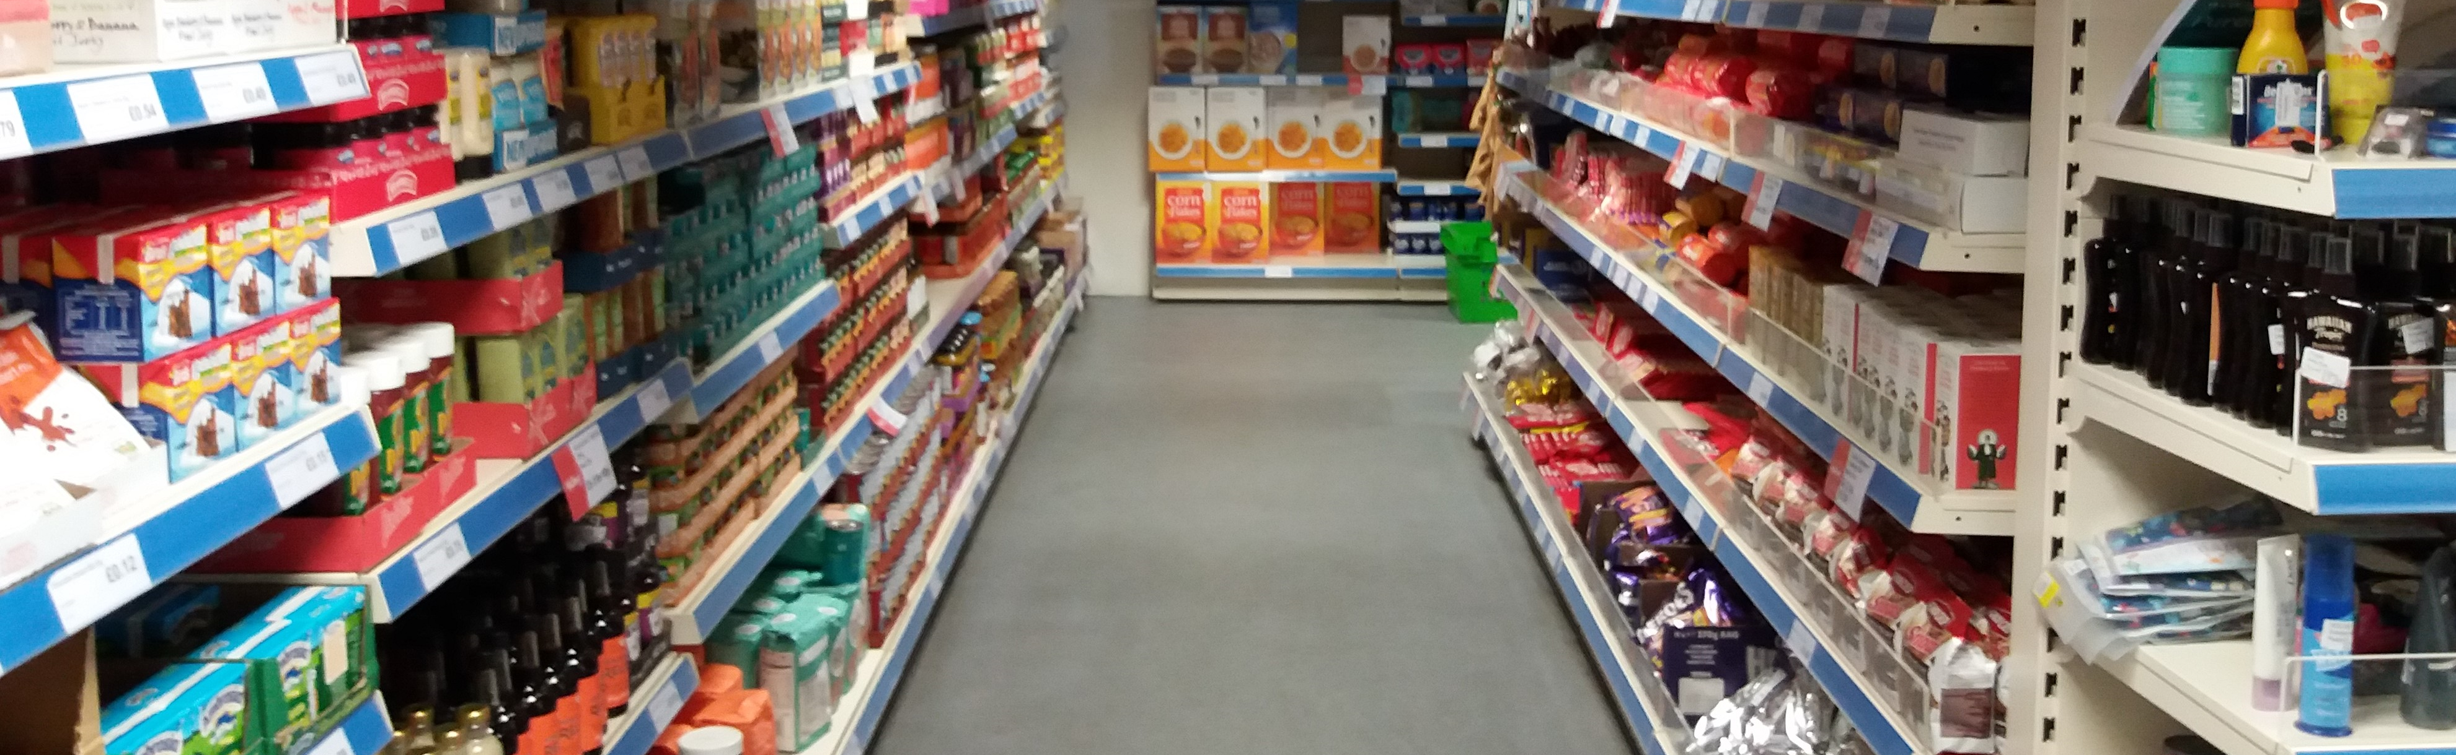
Community Food Retail:
social supermarkets, food pantries & food clubs in Britain
21 September 2019
Dr. Lopa Patnaik Saxena (Coventry University) & Robin Burgess (Northampton Hope Centre)

Slide 2
Outline of today’s session
community food retail
hope and trouble…
Q&As and group discussion
different models in practice

Slide 3
What is community food retail?
Food coops
Food clubs
Food pantries
Fruit & veg schemes
Mobile fruit & veg vans
Social
Supermarkets

Slide 4
Key aspects of SSMs, food pantries & food clubs
Food …
Beyond food provision…
wraparound support (variable)
food used as a catalyst, to build relationships, to bring changes in people’s lives
food used to facilitate a sense of belonging and community
primarily stock food surplus (some non-food goods)
food sold at highly discounted prices, especially directed at those on low-incomes
non-profit business model (social enterprise)

Slide 5
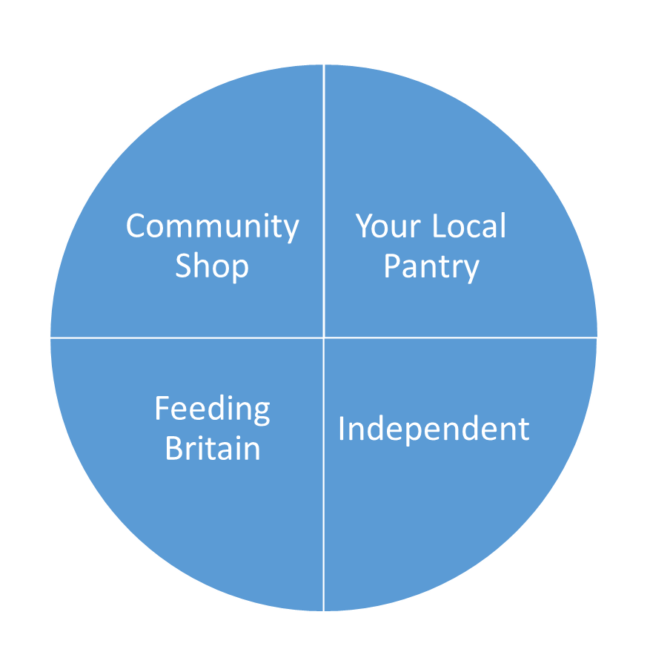
Broadly 4 types in Britain … and a rapidly growing sector
seven ‘parent’ SSMs
‘parent’ SSMs with branches/franchises
(as of Oct 2017)

Slide 6
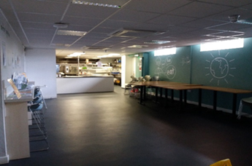
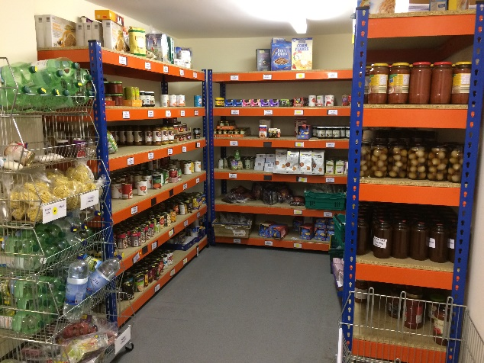
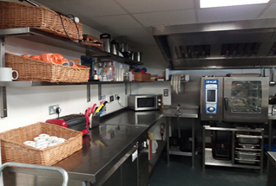
Hope…
emergency relief → non-emergency provision
stigma & shame → more socially acceptable way;
a “sense of dignity”
no choice → choice
handouts → “arm around the shoulder”; “a hand up”
“food isn’t always the only issue”

Slide 7
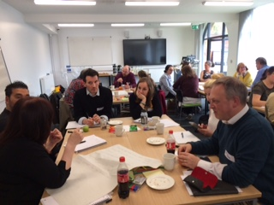
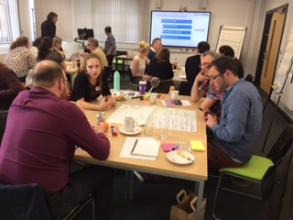
Between hope and trouble… Findings from workshop
Business model
Food Supply
Membership criteria
Additional services
IFAN-CAWR workshop, 20 May 2019, (photos: Jana Fried)

Slide 8
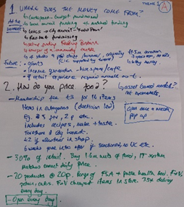
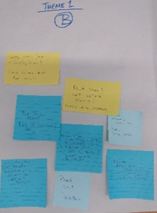
The Business Model
Questions over sustainability & funding base
Who were the customers and how much should they be asked to pay?
Could sales cover costs?
What other sources of incomes could support shops? On-site Cafes?
Was the purpose mainly poverty or did aspirations regarding food waste drive some projects?
No shop attending was breaking even on sales

Slide 9
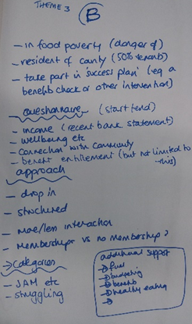
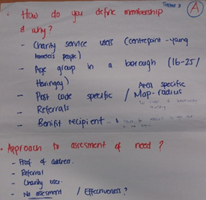
Membership
issues about criteria for membership – income, geography, referral, service users
debate over targeted i.e. to people with ‘problems’ OR open
an individual project choice based on belief and approach

Slide 10
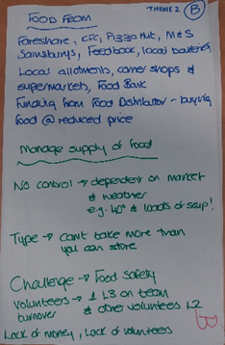
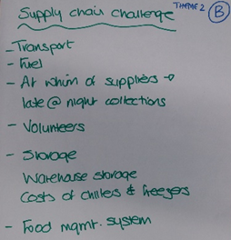
Food Supply
issues of getting enough and diversity of offer
no control over the type nor volume of food
reliance on food surplus -- unpredictability, nutritional content, logistics of redistribution
farms as suppliers or growing themselves -- very few local projects tuned into this
need to engage with community growers?

Slide 11
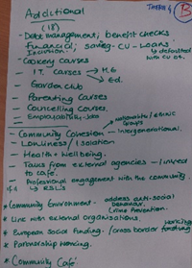
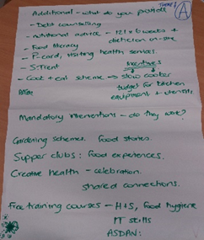
Additional or Add-on Services
a retail outlet only with add-on services available if needed?
services conditional on membership?
debate over assumption of personal ‘pathology’ as the cause of poverty
masking of the real problems -- the need to campaign for better wages and benefits
Could CFR be a provider of the kind of help needed or simply be a signposting service to services that are already stretched?

Slide 12
Points to reflect on...
What is CFR for? For whom?
Food Retail ……………………………… Support/Add-on services
Cheap food ………………………………………. Healthy food
Targeted ………………………………………………. Open
Food poverty ……………………………….Food waste
Short-term …………………………………Long-term
Third sector…………………..Govt
…no place for hunger in our communities
… food surplus redistribution is not the solution for food poverty
... need for a joined-up approach to tackling household food security & wider structural changes

Slide 13
Q&As
group discussion

Slide 14
Thank you
Lopa.Saxena@coventry.ac.uk
robin@northamptonhopecentre.org.uk

