Slide 1
Annual Conference – 15th September 2018
Rethinking Food Aid

Slide 2
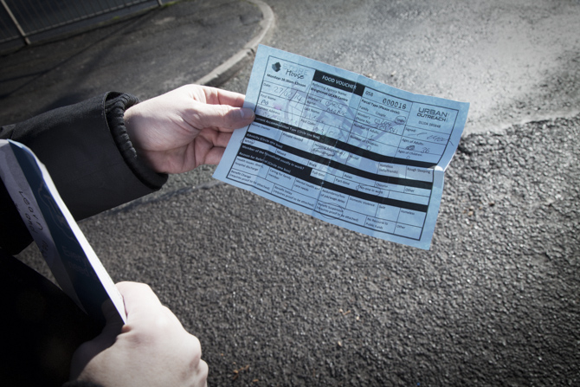
Rethinking rationing and referral
Professor Jon May, Queen Mary University of London
Chair of Trustees (IFAN)

Slide 3
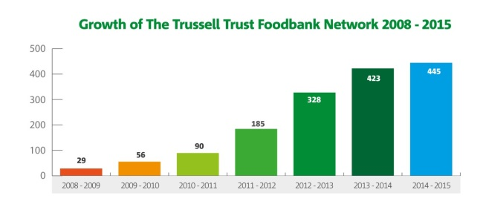
Background and context
Continued rise in demand for emergency food aid and number of food banks
Number of Trussell Trust food banks in 2010 – 78
Number of Trussell Trust and independent food banks and food distribution centres 2018 - 2,009 (Sabine Goodwin, IFAN)
Changes to the benefits system a major driver of demand for food aid
45 benefits capped, scrapped, frozen or reduced in value since 2010 (CPAG, 2017)
Increased conditionality and sanctioning (3.8 million Job Seekers Allowance claimants sanctioned since June 2010 (DWP, 2018))
Errors and delays with Universal Credit - 52% increase in use of Trussell Trust food banks in areas where Universal Credit rolled out

Slide 4
Benefits system also increasingly difficult to navigate, intrusive, and stigmatising
If you're ten or fifteen minutes late you're sanctioned. Often at the job centre, they'll say: ‘it's okay, we'll sort it out’ – but it isn't sorted out, and they are sanctioned. It's just to get the person out the building. Then you've got the people who are on ESA who fail the medical … And … the people who should be on disability benefits like Personal Independence Payments, who – it seems to me there's an automatic refusal … I saw a man this morning who I'd been trying to help for months and … he's getting thinner and thinner and thinner. He is mentally ill, so when he's on Jobseeker’s he misses the appointment and he gets sanctioned. And then he applies for ESA. And there's just been a cycle of ESA, JSA, back and forth. He hasn't had any benefits since March. And he's like a skeleton … (Food Bank Referral Agent 1, London)
The threat of losing or being found ineligible for benefits (is) ever present … concerns were raised (about) feeling judged by assessors for demonstrating particular characteristics or lifestyle choices … (others) talked of feeling that they had to give particular emphasis to things that they could not do … as a necessary requirement for demonstrating genuine eligibility. This was not only unpleasant, but also challenged the way participants viewed themselves and their impairments, impacting on their sense of self. One participant talked with dismay at being encouraged by a welfare rights advisor to alter her appearance ahead of an assessment: ‘You feel as if you’re putting it on . . . I was told [don’t] be too smart in what you are wearing, and don’t make an effort with your hair . . . wear odd socks, literally look like you’re not well’.
Manji, K. (2017) ‘Social Security Reform and the Surveillance State: Exploring the Operation of ‘Hidden Conditionality’ in the Reform of Disability Benefits Since 2010’, Social Policy & Society (2017) 16:2, 305–314, page 309`

Slide 5
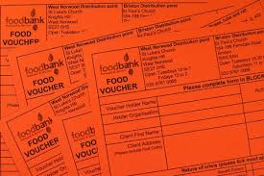
Rationing and referral systems
Against this background, worth examining some of the better known, taken-for-granted, aspects of food bank model to ask whether some aspects of that model may be worsening rather than alleviating problems faced by people who food banks seek to help.
Most UK food banks currently operate rationing and/or referral systems.
Most fully developed in Trussell Trust network (accounting for 2/3rds of UK’s food banks)
Before being given food at a TT food bank, prospective clients must obtain voucher from a referral agency - Schools, GPs, CAB, or Job Centre - who assess and vouch for their need
Clients are expected to present no more than 3 vouchers in any 6-month period (with extensions subject to the food bank manager’s discretion), with each voucher exchanged for 3 days’ worth of food.
Research by Sabine Goodwin (IFAN) suggests about 2/3rds of independent food banks ALSO operate referral.
We do not know how many also operate rationing procedures, but fair to assume most limit either the amount of food a person may collect, or how many times they may receive food, in some way.

Slide 6
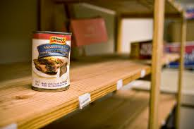
Why ration?
Ever increasing demand: Some food banks struggle to secure enough volunteers and food, and many have to cope with fluctuating donations.
They [the clients] can only come once a fortnight. We can’t give them a weekly bag – we’d love to but, we don’t have the volunteers at the moment. (Manager, Independent Food Bank 1, Midlands)
Because it’s Harvest Festival we’re okay probably for a couple of months. But it tends to get down to …the end of the month before the Harvest Festival, we were having to buy stuff virtually every week. (Manager, Independent Food Bank 2, Midlands)
In the context of scarce resources some kind of rationing seems not only necessary but right: with food going to those most in need, to as many as people possible (a little food for many, rather than more for a few), or with priority given to local people (though why should WHERE one live determine HOW one lives?).

Slide 7
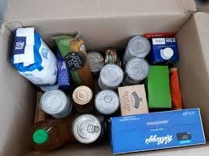
But how much should we ration?
Growing evidence that three days food is not enough (people may wait 5 weeks or longer for their first payment from universal credit, sanctions can last months)
For people in chronic poverty the need for additional food is liable to be on-going, others (for example, those on zero-hour contracts) will likely need to use food banks, even if intermittently, for extended periods of time: 3 visits unlikely to be enough.
Well - it’s only me eating it at the moment, so I think [the 3 day parcel will last] about a week, week and a half maybe.
- And what will you do when it runs out?
Well, if my money wasn’t coming then I’d obviously have to - come back. But then again, I would have used my three vouchers by then, you see. So ... (Food Bank User 1, TT Food Bank 1 , London)
Evidence that even people in desperate need are saving their vouchers for when they hit a ‘real crisis’
Interviewer: Have you been able to use food banks as much as you want or need to?
Respondent: No, because you can only get a certain amount of tokens a year … I haven’t actually used [all] mine. I mean, the one I gave to the gentleman is actually old. I don’t use it, cause I only, like, if it’s an emergency for me, it’s an emergency … (Food Bank User 2, Food Bank 1, London)

Slide 8
If one food bank restricts access, or rations, it can increase pressure on other food banks in the area who may have more generous allowances i.e. the attempt to manage scarcity in one place, increases problems of scarcity for others.
Because we’re oversubscribed and we’re always struggling for food, we can’t really take people out of our area. But we won’t send you away empty-handed. You’ve made the effort to come. We will give you a bag on a one off basis. Now this guy kept coming back every two weeks. We kept saying, ‘Look, there are other food banks in the city’– but unfortunately he doesn’t have a referral, so he can’t. (Manager, Food Bank 5, Midlands)

Slide 9
Why use referral?
Stock management
Standardisation
Campaigning: referral system collates statistical evidence on food bank use
Reduces stigma: some have suggested people less worried about talking to professionals they may already know than to food bank volunteers, and reduces stigma at the food bank itself if people feel they have a ‘right’ to be there (because they hold a voucher)
Consistency and fairness: removes discretion (welfare professionals less likely to succumb to the prejudices that can hinder the judgement of volunteers).

Slide 10
But how well do referral systems work?
People in need don’t always know how the system works
I think the referral system works once you’ve found out how you can be referred. It’s the pre-referral that I think doesn’t work very well. If you asked … my mother … how do you get food from a food bank, she’d have no idea … if you interface with … your GP, or your kids are at school, or [you belong to] a church, you’re probably okay. But if … you’re generally fit, you haven’t got any kids, you don’t go to a hospital, you don’t have anything to do with the police … I don’t think you’d know how to do it. (Volunteer, Trussell Trust Foodbank, London)
Referral agents don’t always know how the system works – who can offer referrals, or where they should refer people to
I: Would you ever send someone to ask their GP, or their social worker, or their children's school (for a voucher)?
R: You know what, I don't think I knew that GPs had food vouchers. Do they? … Since I started the role, I’ve had real difficulty trying to find out where the foodbanks are, and what their referral criteria are (Food Bank Referral Agent, Midlands)
Navigating referral systems can be as frustrating and alienating as navigating the benefits system
Paul (pseudonym) entered, notably distressed, and recounted the journey he had made. He explained that after having been rejected from **** food bank (because his food voucher was invalid), he and his friend were advised to make the twenty-six mile journey to a food bank in ****, via bus. Paul and his friend queued for a food parcel, but were rejected for a second time by the food bank as they had run out of food by noon – finally, being sent back to a day centre [in their original port of call] to ask if they could supply any sort of parcel. (Field notes / Rural Independent Foodbank 2017)

Slide 11
Displacing stigma
Though vouchers may reduce the stigma people feel approaching a food bank, rather than reduced this stigma is displaced to their encounter with referral agents: It’s not one-to-one. You have to go inside the waiting room, and you have to tell them why you’re going there, and this, that, and the other … I actually have to say that I’ve come for a foodbank voucher. And then … everyone can hear you. … I do feel embarrassed. I know I shouldn’t do, but I do. And I always say to her, when you give it to me, can you put it in an envelope? ... Because I’m sure they [the other customers] know what it is … you don’t have to read what it says on the piece of paper, you know it’s charity. ‘I’ve no food, give me food, I’m begging for food.’ Do you know what I mean? (Food bank client 1, TT Food bank 1, London)
People can be reluctant to be ‘tarnished’ by asking people they know (for example, their child’s teacher) for a voucher for food: See, I find the schools… when I would ring up and say: ‘Could you help this person? Their benefits haven't come through so they're not entitled to school meals yet – is there anything you can do?’ I find schools very reluctant to help. And I find with parents they're very ashamed to admit it to the school. So, I'm not sure if they would ask for food vouchers very much (Food Bank Referral Agent 2, London)
Scarred by their experiences with benefits and other state agencies, people can be worried about giving agencies too much information (risk of a call from social services, or sanctions): If they have to go through all the agencies, they have to say their name, how many kids they’ve got, then they worry about ‘Why do they want to know how many kids I’ve got? ... I’m going to be investigated’. .(Volunteer, independent Food Bank, London)

Slide 12
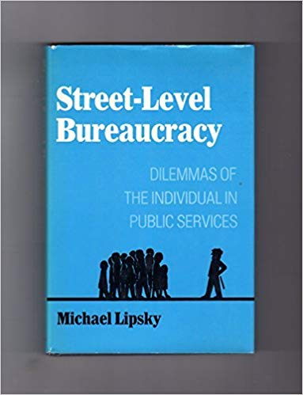
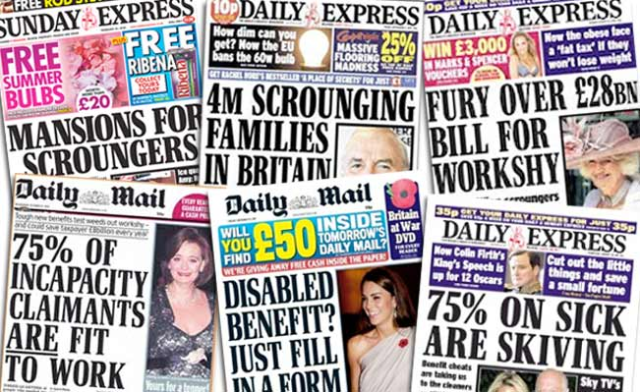
Discretionary judgements
Food bank managers reported they used referral agencies to avoid the discretionary and potentially prejudicial judgements by volunteers because:
The problem is that volunteers have got their own views, and they read the newspapers and … are as susceptible to stereotyping as anybody else … (Assistant Manager, Trussell Trust food bank, South West England)
But ‘welfare professionals’ also have their own values and operate according to their own discretion.

Slide 13
When assessing claimants, referral agents are asked not only to record the ‘nature of the crisis’ that led a person to them, but to make a judgement as to whether that person is in ‘genuine need’ – a question which often elides in to questions as to whether a person is ‘deserving’ of help (for example, whether they have tried to manage their finances properly, and may refuse to issue a voucher in an attempt to ‘encourage’ them to do so in the future):
The city council don’t believe you. They told me that I couldn’t get a voucher and that I should ask my family to help me (Foodbank client, two children, South West England)
I think [vouchers] offer a bit of protection to the food bank … if people just turned up to the food bank it would be like going shopping … It's not that it makes it difficult for people, it's that it makes it a sort of official process that they have to go through … It's not onerous enough to put people off using it, but I think it's enough to stop people who are just a bit lazy and can't be bothered to manage their finances properly, or whatever it is – to just turn up and go, ‘I haven't got any money, can I have some food?’ … if people know there's a limit, it helps them to focus (Food Bank Referral Agent, London)

Slide 14
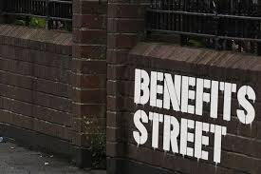
Moral outsourcing
Rather than removing discretion from the system, the referral system displaces discretion from the food bank volunteer to welfare ‘professionals’.
Discretionary judgements seem very often to be made on moral grounds; moving around quite traditional (and stigmatising) distinctions between the ‘deserving’ and the ‘undeserving’.
It is these judgements that often seem to underpin both rationing and referral systems, which tend to operate in tandem as ways of preventing people ‘abusing’ public generosity (only those found in ‘genuine need’ by ‘welfare professionals’ can access food), avoiding ‘dependency’ (limited number of visits, though what’s wrong with being ‘dependable’?), but also protecting food bank volunteers from having to deal with the ethical dilemmas involved in deciding who or who should not have food – a form of ‘moral outsourcing’.
I think the [referral] system is very useful, because it divorces our volunteers from the decision of who actually has a food parcel … Some of our volunteers would find it very difficult to be the person who has to say yes or no to somebody, so I think the fact that that decision is made elsewhere is a real strength. (Former Trussell Trust Food Bank Manager, South Wales)

Slide 15
Moral distance at the food bank
Voucher systems raise other concerns too.
Just as counters and tables, uniforms and name tags, can create a sense of distance between volunteers and clients, vouchers do the same thing – as people become a voucher to be processed rather than a person to be cared for.
(Some) food bank volunteers can seem more concerned with ensuring the system runs smoothly than helping people in need; with food provided only when a person has the right voucher, rather than according to need.
… a lady came in last week with a voucher, she comes quite often - and always - you know,‘ I’m doing it for somebody [else]’ … And I had to go back and say, ‘What’s happening with this voucher? … you’re not eligible’ … So we went through this and she said, ‘can you just let us have this once, because we promise we’ll never come back again’. And I said, ‘I’m afraid that’s not how it works’. And – ‘oh in that case, can we have the voucher back and we’ll go to another food bank?’ So, I said ‘No, the food bank system, it counts as everything. You can’t just go to **** or wherever and use the same voucher. That’s not how it works’. I said, ‘What we’ll do is, we’ll keep the voucher, and if you come back in eight weeks, and if you haven’t got another voucher, you can use the one we’re retaining for you’ (Volunteer 4, TT Food Bank, London)
For example, this guy … [had] brought his bits and pieces and all this kind of stuff. And I said, ‘Tell me who you are and why you’re here.’ And he says, ‘Well, this is my situation’ … And he shows me letters to show this is his situation, and it's fine. It's as simple as that. [But] when someone arrives ... they have no ID, no letters, they have no proof, they have no evidence – I will turn them away. Because I don't have any choice. (Manager, Trussell Trust Food Bank 1, South Wales Valleys)

Slide 16
Suspicion and distrust
In the worst cases, voucher and referral systems breed distrust and suspicion – towards both people in need, and (ironically) the referral agencies in which some food banks apparently place such trust.
I think the referral system is important, but I think … there needs to be some fairly robust monitoring so that people don’t take … advantage of it. I mean, we have – you are probably aware, **** has what she calls her miscreant file, and once a month she looks up on the database anybody who has had more than three vouchers and then once a month I phone those agencies to enquire why the person has had more than three vouchers if they haven’t notified that that’s going to be the case. And it’s really helped us to be quite clear in making sure that people genuinely need the vouchers and they genuinely need the food when they come to us. We don’t get many people that slip through the net, who are abusing it. (Assistant Manager, TT food bank, South West England)
Inevitably, with 50 referral agencies, and each of those referral agencies with quite a large number of signatories, they will be interpreting things in a different way. So we did have a situation whereby one referral agency was giving out a large amount of vouchers ... and did seem out of kilter with other referral agencies. So we went and visited them. Not to tell them what to do, but to explain the situation did look slightly unusual compared with others, and just had a conversation with them, and it made them consider more carefully their own criteria for providing vouchers. (Manager, Trussell Trust Food Bank 3, South Wales Valleys)

Slide 17
Conclusions
Rationing may be necessary and can seem the ‘right thing to do’ in a context of scarce resources. But we need to be clear of the bases on which we ration.
Very often rationing (both the amount of food and number of visits) seems to be based on an implicit distinction between the deserving and undeserving, re-enforcing rather than challenging the distinctions found in political rhetoric, poverty porn, and the benefits system.
Despite their widespread use, referral systems can be difficult to navigate and do not always work very well.
Despite the trust they place in them, food bank managers do not always trust the referral agencies on which they rely.
Rather than reduce, referral systems displace the stigma, discretion, and moral(istic) judgements that can characterise some food banks from food bank volunteers to referral agents.
If we use referral systems to collect data to use in campaigning work why not collect this data in another way?
If we use them because we want to help people connect with agencies that may be able to help them longer term, do we not already do this through our signposting?

Slide 20
Introduction
The Welcome Network is a project funded for 3 years (April 2017 - 2020) by Cheshire West and Chester Council (Health & Inequalities Fund)
Strategic partners:
West Cheshire Foodbank,
Citizens Advice Cheshire West,
Healthbox (Public Health CIC)
Chester Voluntary Action
Cheshire West and Chester Council (Officers and Elected Members)
Including Cheshire West Poverty Truth Commission

Slide 21
The Welcome Network aims to support:
A move from transactional approaches to food poverty to building relationships
The creation of spaces for neighbours and agencies to come together and build relationships
Reducing stigma by providing accessible, welcoming environments to access food, activities and support
The development of a variety of locations and activities to improve accessibility to food and support for diverse communities

Slide 22
Brief History
Desire to move from a ‘transactional’ to a ‘relational’ model of food provision
Summer 2016 - partners seeing the value of working together
Used some of the principles of ‘Feeding Birkenhead’ - Became a ‘Feeding Britain’ pilot area
Funding was secured in March 2017 to allow for 3 staff to develop the partnership/network across the Cheshire West and Chester Borough

Slide 23
Examples
Foodbank Sessions not run in isolation
Snack & Chat
Citizens Advice in community space
Pop Up Cooking
Recipe Sharing
Community Food Festivals
Supporting Community Groups with Funding (from Feeding Britain/DfE) to provide food at Holiday Clubs
Removing barriers to attending local Leisure Centre/Theatre
Access to Food Hygiene Training

Slide 24
The Joys of The Welcome Network
Someone/Something to have time and energy to make connections
Sharing learning/connections
Pooling resources to review/assess ways of working
Many people working towards the same aim - achieving more together than on their own
Relationship Relationship Relationship

Slide 25
The Challenges of the Welcome Network
The partnership process has been hard work
Relationships take time - between everyone involved
Evaluating/evidencing the value that the Network/Partnerships are bringing to addressing the issue of Food Poverty
Ensuring the voices of people with lived experience are heard and part of the network

Slide 26
Case Study

Slide 29
The Meeting Place
An initiative piloting an alternative approach to our existing food distribution sessions
A collaborative initiative between Cheshire West Citizens Advice and West Cheshire Foodbank
Funded by the Westminster Foundation
Aligns with the values of the Welcome Network

Slide 30
5 Key Principles of The Meeting Place
Welcoming Social Space
Dignity in Practices
Development of Skills and Self-Esteem
Sharing of Food and Drink
Accessible Advice and Information
“Genuine conversations in social spaces, rather than evaluations of people, lead to specialist support and meaningful change in a person’s life”

Slide 31
Key Strengths of the Project
“the positive attitude of everybody that attended today made it so easy to feel welcome. I have learnt a lot from one session and I won’t be offending again. It has had a real positive impact on me”
“I’ve had a thoroughly enjoyable day amongst good caring people. Looking forward to next week”
“I must say that I’ve been a few times, I LOVE it – friendly, non-judgmental folk. Its really great to work with your hands and get lost in the friendly banter so please give it a try as it definitely surprised me, I look forward to it”
‘since participating in this community group I have felt a great sense of purpose, connection and learnt what it means to be functional again. The staff and participants have helped me to feel re-engaged with society, as towards the start of the group sessions I felt quite isolated”

Slide 32
Two Key Areas for Development
Exploring alternatives to the voucher model
Developing tools for evaluating The Meeting Place

Slide 34
Questions for discussion;
What is your experience of referral & rationing?
Do you have good practice examples where alternative models are working well (home and abroad)?
Do you have examples of areas where alternative models are being tried but there are significant challenges being faces?
What could an alternative model of data collection look like?
Do you have any examples of people who have experienced food insecurity/poverty being involved in shaping an alternative referral process?

Slide 35
Annual Conference – 15th September 2018
Rethinking Food Aid

