Slide 1
Money Counts:
Training using the Worrying About Money? leaflet.
WELCOME
* Based on an original resource developed by the Highland Money Counts Partnership

Slide 2
Guiding Principles
Brief introductions
Cameras – on or off, whatever works best for you
Microphones on mute please
(unless you are speaking)
Raise your hand to ask a question
Use the chat to interact (if you can)

Slide 3
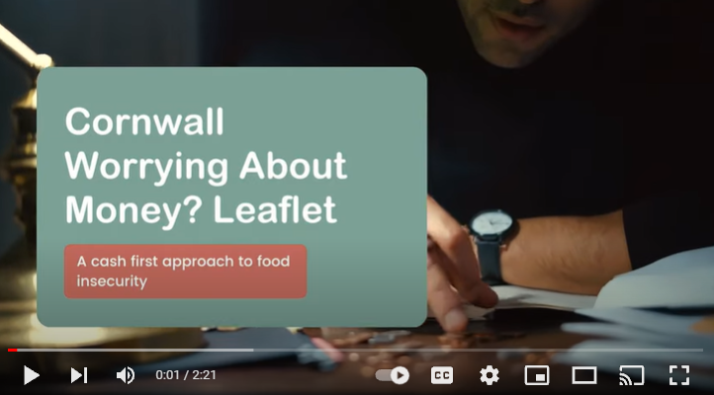
Cornwall: Worrying About Money? Leaflet
https://www.youtube.com/watch?v=yG4oreVAQvY

Slide 4
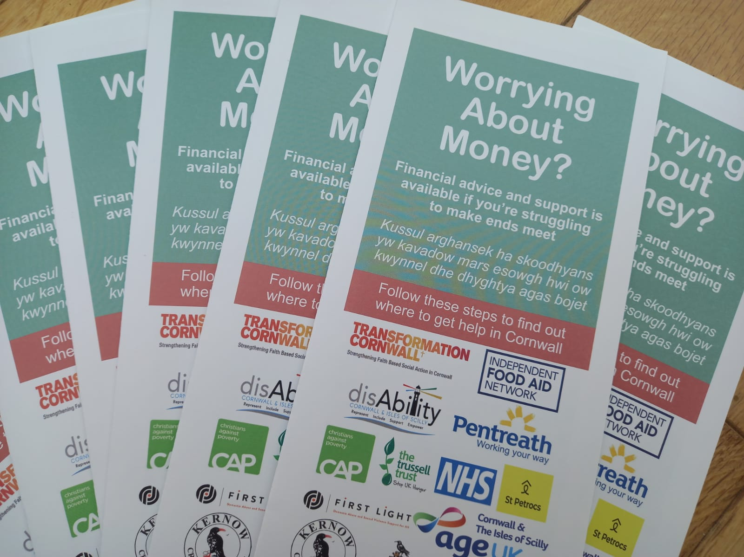
Learning Outcomes
To use the Worrying About Money? leaflet well and with confidence

Slide 5
Learning Outcomes
Increase understanding of poverty and its impact
Increased confidence to ask about money worries
Increase knowledge of support services for money matters (including Citizens Advice Cornwall)

Slide 6
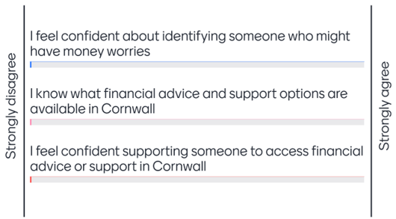
Go to menti.com
and use the code 45453773

Slide 7
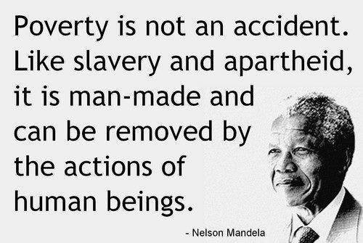
Poverty
‘Poverty is when a person’s resources are well below their minimum needs, including the need to take part in society.’
Joseph Rowntree Foundation, Nov 2017

Slide 8
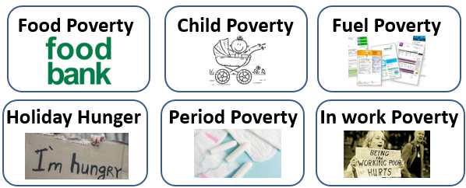
Types of poverty
But poverty is still poverty…

Slide 9
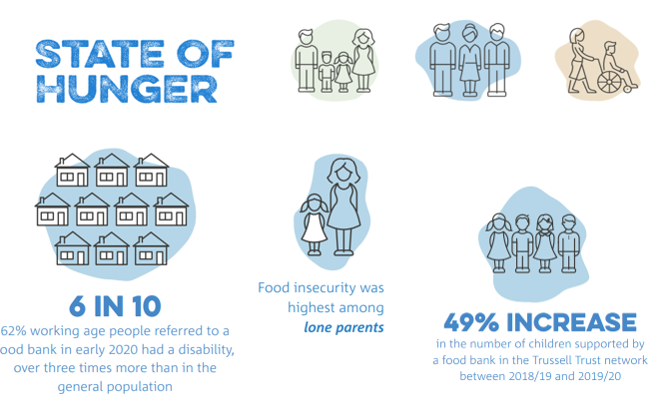
Who is likely to be living in poverty?
* Trussell Trust data May 2021

Slide 10
What Can We Do?

Slide 11
How can Citizens Advice Cornwall Help?
Citizens Advice Cornwall has a range of support services to help people with money problems or worries, eg:
Money Management or budgeting
Benefit entitlement and help to claim
Debt Advice
Managing ongoing costs

Slide 12
Money problems are frequently related to other problems
Job loss
Loss or drop in income because of illness
Relationship breakdown
Benefit decisions
Housing problems
Low household income
Sudden unexpected expense
Debt and arrears/Pressure from creditors

Slide 13
Citizens Advice Cornwall takes a holistic approach to advice and support:
To help with the immediate problem
To provide advice and support on dealing with related problems
CA Cornwall provides advice across:
Money and Debt | Benefit entitlements
Work | Housing
Family and Relationships | Health
Law and Courts | Immigration

Slide 14
Initial exploration of client circumstances – in most cases the presenting problem is not the only problem
Identifying the client options and agreeing a course of action
Referring internally within CA Cornwall
Where appropriate, signposting the client to external agencies

Slide 15
Money Matters Project
What We Do:
The Money Matters Project is funded by Cornwall Council Together for Families and we work independent of, but in conjunction with, Family Workers and Social Workers to help families with children under 18 (or under 25 where there are Special Educational Needs.)
Refer the family through the Partner Organisation Referral portal at the bottom of the Citizens Advice Cornwall website and we will do the rest.

Slide 16
Money Matters Referrals
We have a referral form you can use at the following web address: https://www.citizensadvicecornwall.org.uk/third-party-referral-form/
When asked for the password it is cabrefgreen27

Slide 17
CA Cornwall may be accessed in a number of ways
By texting the word ADVICE to 78866
By calling 0800 1888848
Visiting www.citizensadvicecornwall.org.uk
Advice and support delivery options include
Drop-in sessions across 9 offices in Cornwall (currently restricted because of Covid)
Face to Face (by appointment only)
Telephone advice
Webchat/digital advice hubs
Video calls

Slide 18
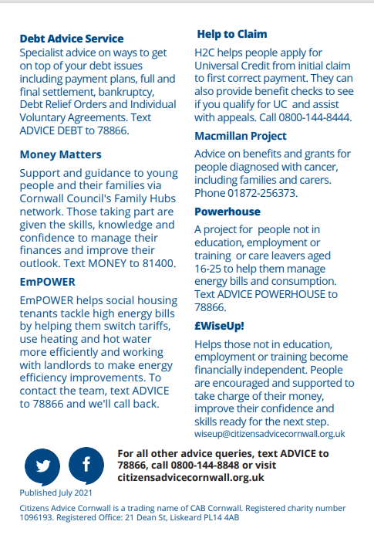

Slide 19
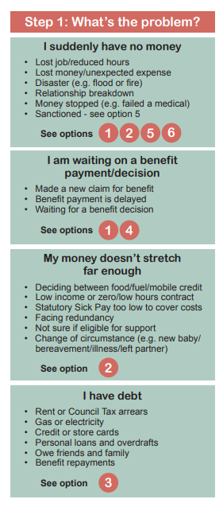
I suddenly have no money
I am waiting on a benefit payment/ decision
My money doesn’t stretch far enough
I have debt

Slide 20
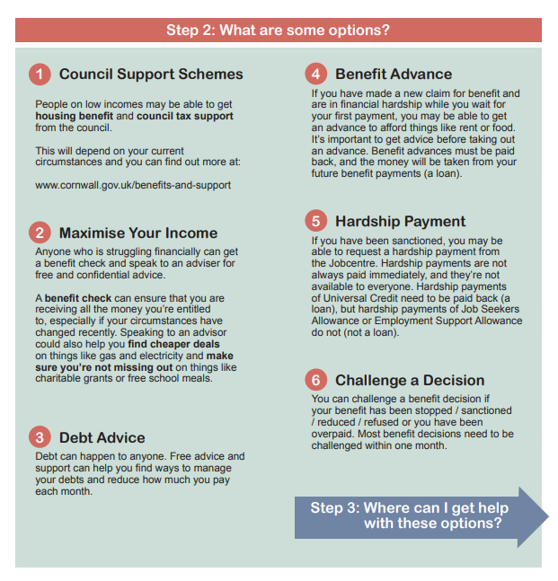

Slide 21
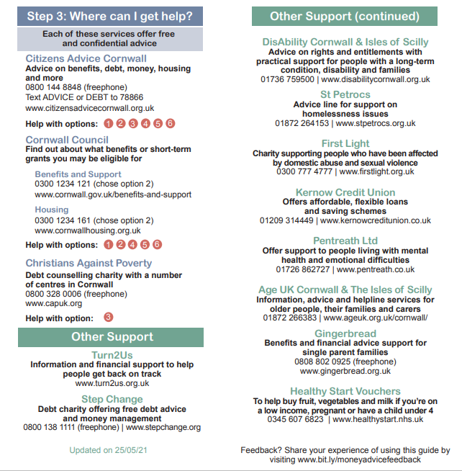

Slide 22
How to access the
‘Cornwall: Worrying About Money?’ leaflets?
https://www.foodaidnetwork.org.uk/cash-first-leaflets
You can access cash first referral leaflets currently by contacting your Money Matters Representative in your Family Hub

Slide 23
How might you use the leaflet?

Slide 24
Framing the Question...
Breaking the ice….
Listening
Using open questions
Asking permission
Exploring the information
Offering up information
Not making assumptions
How can I help?

Slide 25
What do you know about support from Cornwall Council/Citizens Advice Cornwall? Can I give you more information on any of these?
There are lots of people struggling with money at the moment. Would you know where to get support if you needed it?
What are your thoughts on contacting another organisation that can offer help?
Asking the question...
Can I give you information about a leaflet that other people have found helpful?
Can I ask if you have seen this leaflet?
When someone accesses our service, there may be more help we can provide. Can I help you with anything else?

Slide 26
Go to menti.com
and use the code 45453773

Slide 27
Accessing services – real stories
https://www.youtube.com/watch?v=gPI83kw442U

Slide 28
Any Questions?
Find out more about cash first referral leaflets: www.foodaidnetwork.org.uk/cash-first-leaflets
David Morton (Citizens Advice Cornwall)
david.morton@citizensadvicecornwall.org.uk
Sophie Holland (Citizens Advice Cornwall)
sophie.holland@citizensadvicecornwall.org.uk
Emma Greenwood (Trussell Trust)
emma.greenwood@trusselltrust.org
Jane Yeomans (Transformation Cornwall)
jane@transformation-cornwall.org.uk

Slide 29
This training is based on resources developed by the
Highland Money Counts Partnership.
Partners include The Trussell Trust, NHS Highland, Highland Council and Social Security Scotland, in partnership with the Independent Food Aid Network and Nourish Scotland.

