Slide 1
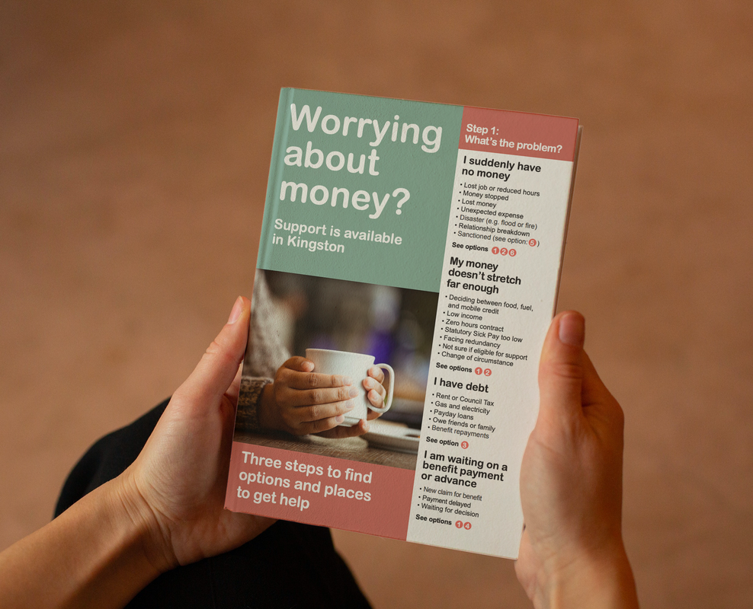
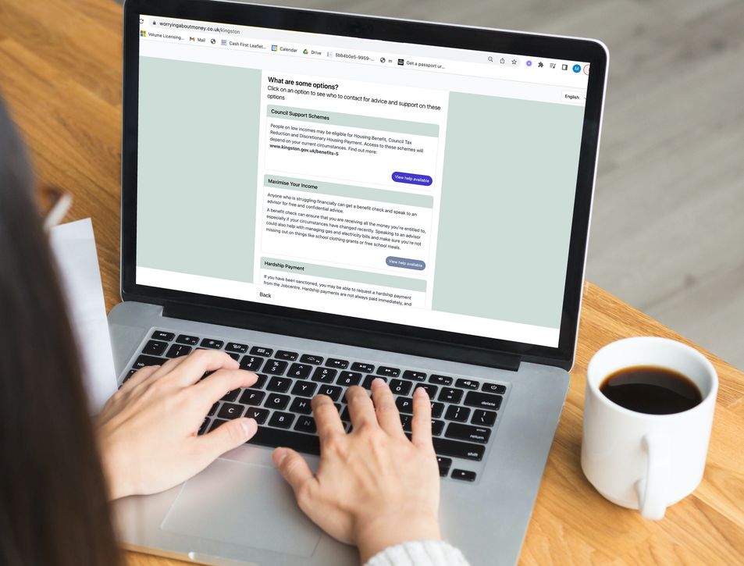
Money Counts: Using the Renfrewshire 'Worrying about money?' leaflet
* Based on an original resource developed by the Highland Money Counts Partnership

Slide 2
Guiding Principles
Brief introductions
Cameras – on or off, whatever works best for you
Microphones on mute please (unless you are speaking)
Raise your hand to ask a question
Use the chat to interact (if you can)

Slide 3
Learning Outcomes
Increase understanding of poverty and its impact
Increased confidence to ask about money worries
Increase knowledge of support services for money matters

Slide 4
Mentimeter
Go to menti.com
Use code: 3434 4203

Slide 5
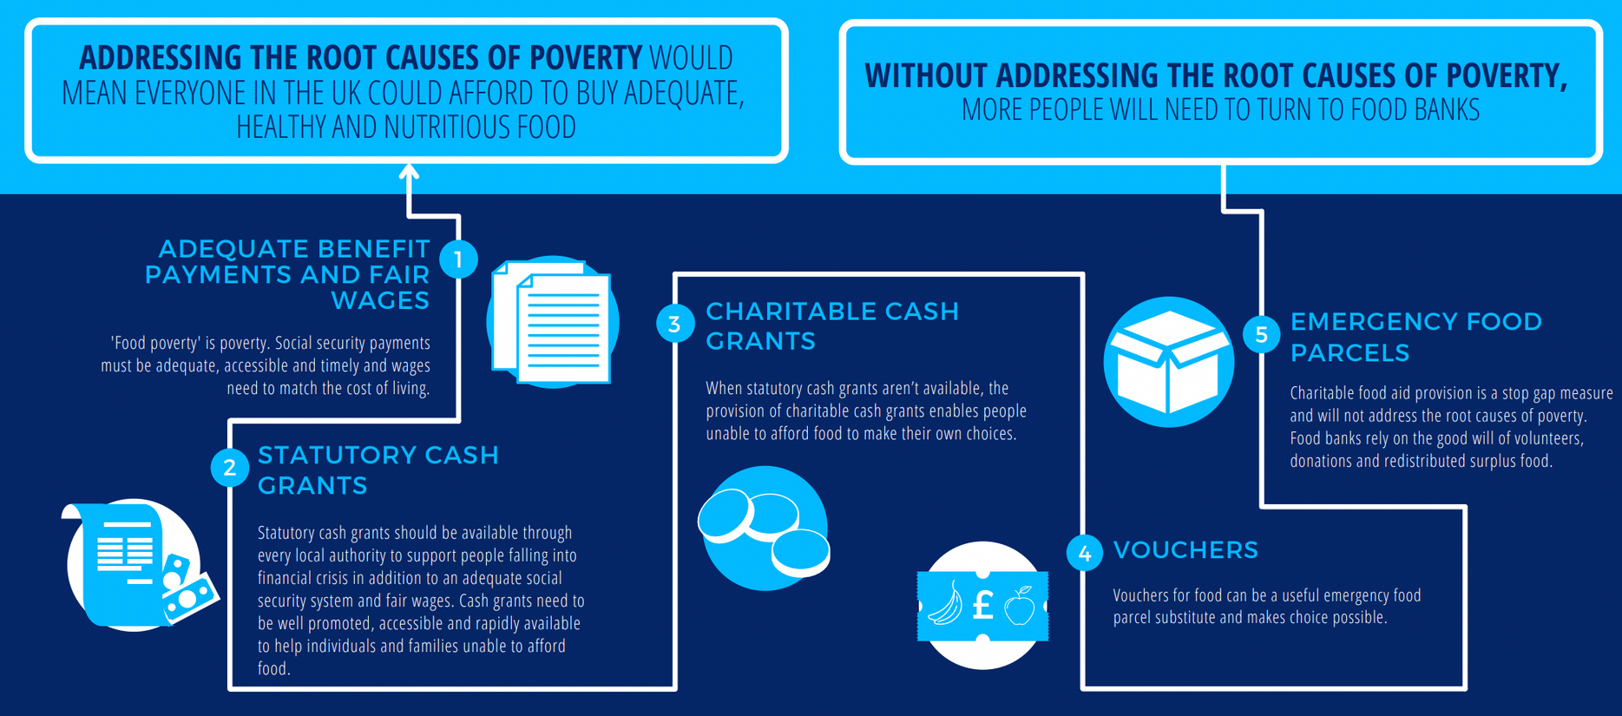
What is a 'cash first' approach to food insecurity?

Slide 6
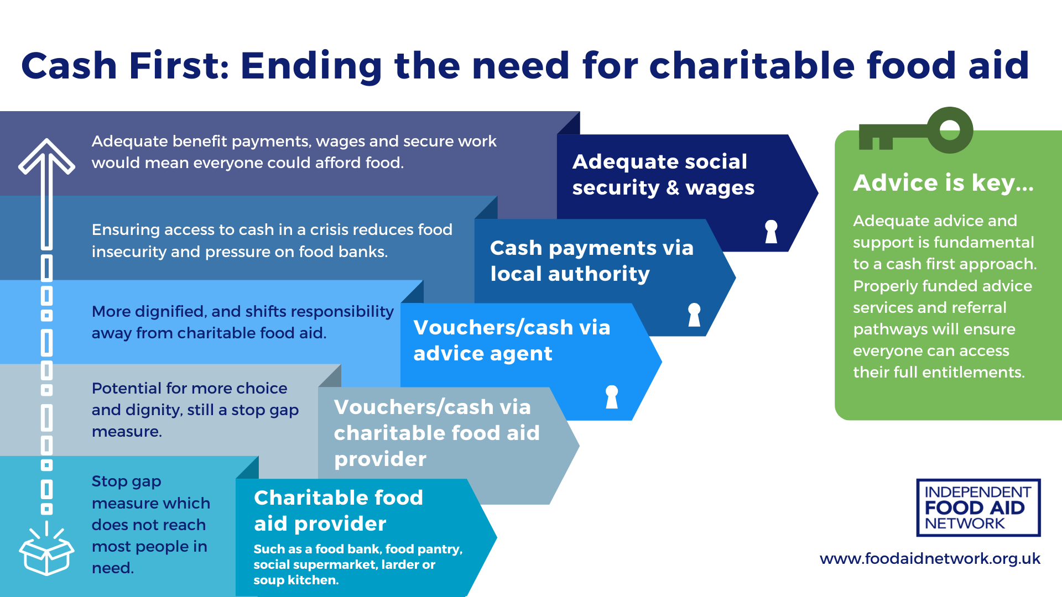
What is a 'cash first' approach to food insecurity?

Slide 7
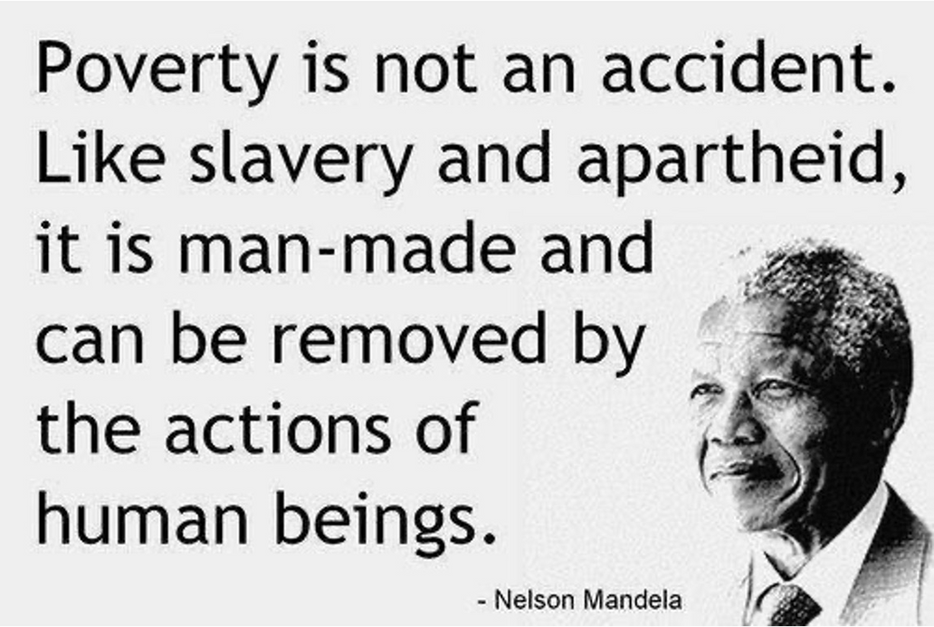
Poverty
"Poverty is when a person’s resources are well below their minimum needs, including the need to take part in society." - Joesph Rowntree Foundation (Nov, 2017)

Slide 8
Cash First is Common Sense
Watch a brief video of our infographic explaining Cash First
https://www.youtube.com/watch?v=0vPdD6mjS9g

Slide 9
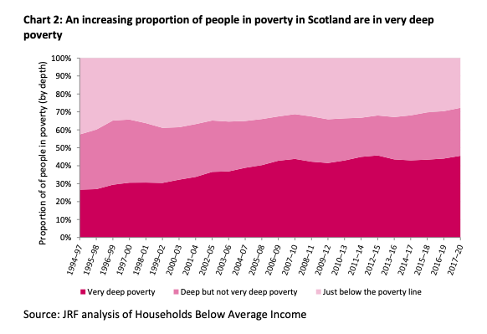
Impact of inflation
1994-97 people in very deep poverty was 27%
2017-20 people in very deep poverty was 46%
In October 2023, food inflation at 13.6% (ONS)

Slide 10
Food insecurity beyond the use of food banks
14%
86%
Severe food insecurity seen in food banks
Severe food insecurity NOT seen in food banks
DWP Family Resources Survey April 21 - March 22 (Published March 2023) shows that 3% of UK households reported very low food insecurity in the previous 30 days. But 86% of this number were not found to be using a food bank

Slide 11
What can we do?

Slide 12
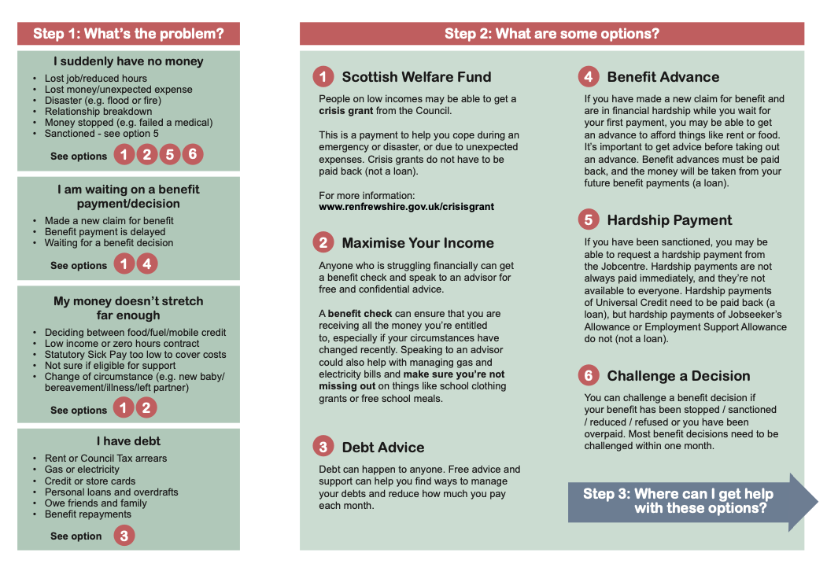

Slide 13
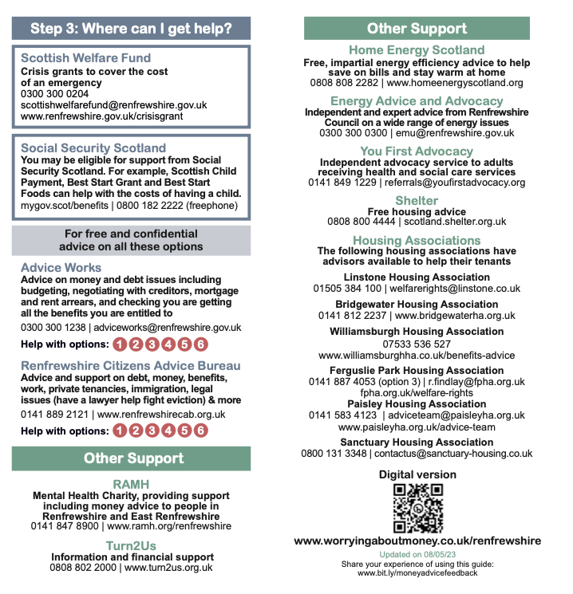

Slide 14
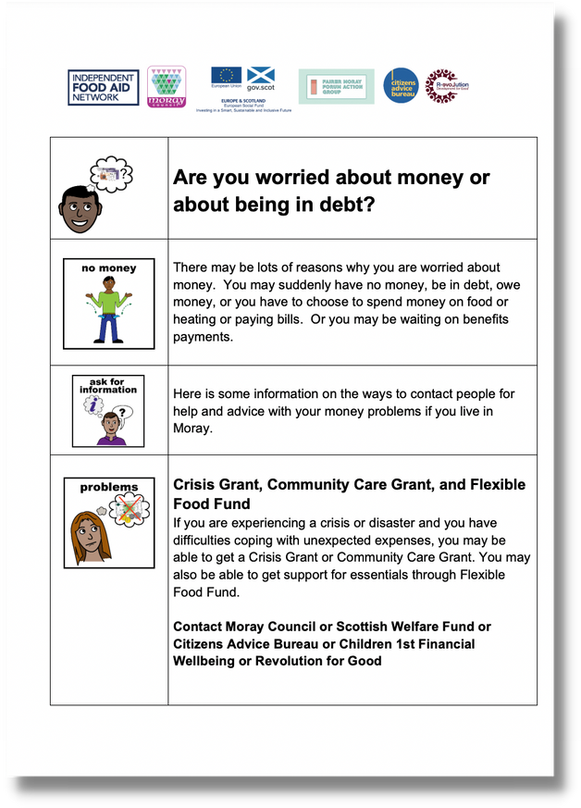
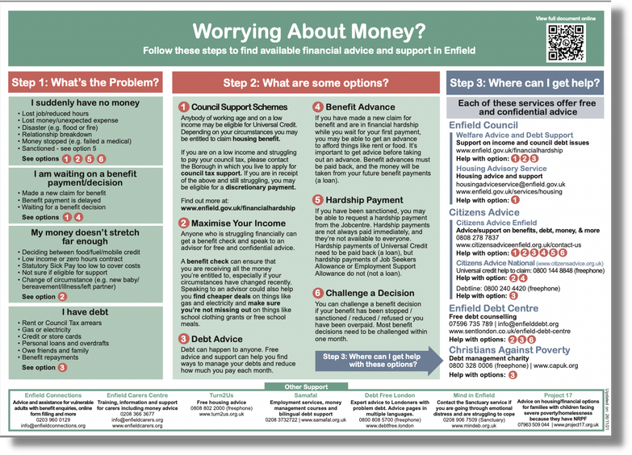
Alternative versions:
Translations, posters, interactive version, easy read

Slide 15
How to access the 'Worrying about money?' leaflets
Request for printed copies: www.ifanuk.org/print-req
Digital leaflet: www.worryingaboutmoney.co.uk/renfrewshire
Leaflets are also available in various locations in Renfrewshire

Slide 16
Renfrewshire
Citizens
Advice Bureau
“To profit from good advice requires more wisdom than to give it”

Slide 17
How might you use the leaflet?

Slide 18
Framing the question...
Breaking the ice….
Listening
Using open questions
Asking permission
Exploring the information
Offering up information
Not making assumptions
How can I help?

Slide 19
Asking the question...
What do you know about support from Citizens Advice? Can I give you more information on any of these?
There are lots of people struggling with money at the moment. Would you know where to get support if you needed it?
Can I give you information about a leaflet that other people have found helpful?
What are your thoughts on contacting another organisation that can offer help?
Can I ask if you have seen this leaflet?
When someone accesses our service, there may be more help we can provide. Can I help you with anything else?

Slide 20
Mentimeter
Go to menti.com
Use code: 3434 4203

Slide 21
Questions
Find out more about cash first referral leaflets: www.foodaidnetwork.org.uk/cash-first-leaflets
Contact
admin@foodaidnetwork.org.uk

Slide 22
Thank You
This training is based on resources developed by the
Highland Money Counts Partnership.
Partners include The Trussell Trust, NHS Highland, Highland Council and Social Security Scotland, in partnership with the Independent Food Aid Network and Nourish Scotland.

