Slide 1
Money Counts:
Training using the Worrying About Money? leaflet.
WELCOME
* Based on an original resource developed by the Highland Money Counts Partnership

Slide 2
Guiding Principles
Brief introductions
Cameras – on or off, whatever works best for you
Microphones on mute please
(unless you are speaking)
Raise your hand to ask a question
Use the chat to interact (if you can)

Slide 3
Learning Outcomes
Increase understanding of poverty and its impact
Increased confidence to ask about money worries
Increase knowledge of support services for money matters

Slide 4
Confidence to talk about money?
On a scale of 1 – 10, where 1 is no confidence
and 10 is very confident - How would you rate
your confidence to talk to someone about money?
Notes:
Can you pop your responses in the chat

Slide 5
Knowledge of support
On a scale of 1 – 10, where 1 is no knowledge and 10 is high level of knowledge- How much do you think you know about services which help people maximise their income?
Notes:
Again, can you pop your response in the chat as either a number or low, medium or high

Slide 6
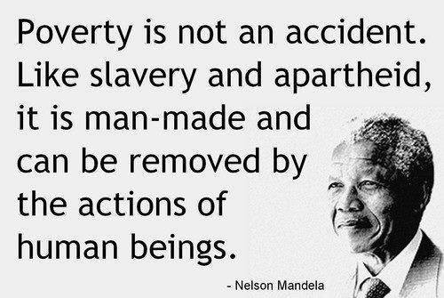
Poverty
‘Poverty is when a person’s resources are well below their minimum needs, including the need to take part in society.’
Joseph Rowntree Foundation, Nov 2017
Notes:
There are many definitions of poverty but this is a short and simple one. It highlights that we need money to take part in society and doesn’t just reference money as something we need to pay for services and bills.
Think about what we use our income for? What things are basic necessities (food, heat, shelter – think of Maslows hierarchy of need) and what are luxuries? Is a mobile phone a luxury, having access to the internet, being able to socialise? If for example you are applying for Universal Credit, you have to do this online and then you are expected to job search online, keep a journal which work coaches can access and these all need broadband. You can get free internet access in place like the job centre, libraries and work clubs but that means getting to these place if you can and they may not be easily accessible in remote and rural area.
Quote by Nelson Mandela – highlighting that poverty is man-made. Through collective action society has created it – but through collective action we can also help to impact on it too.
https://www.jrf.org.uk/our-work/what-is-poverty - for more information on the cause of poverty and the impact.

Slide 7
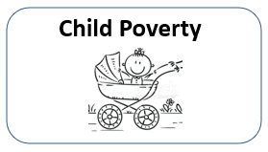
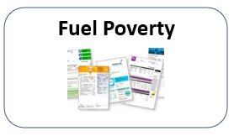
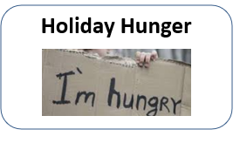
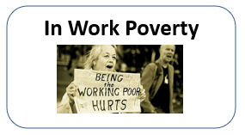
Types of poverty
But poverty is still poverty…
Notes:
Can you name some types of poverty – use hands-up or the chat function.
Poverty no matter what name we give it is still poverty – there is sometimes a big emphasis on child poverty but in order for a child to be in poverty, the adult that cares for them must be in poverty.
It can be helpful to think of different types of poverty to recognise the depth and breadth of the problem but we need to tackle it as a whole

Slide 8
Who is likely to be living in poverty?
A household with a disabled member
Children
Ethnic minority groups
Working age people
Pensioners
Notes:
https://povertyinequality.scot/poverty-scotland/
1 in 4 children in Scotland (26%) are living in poverty
1 in 5 working age people (20%) in Scotland are living in poverty
13% of pensioners in Scotland are living in poverty
58% of people in poverty and 70% of children in poverty live in a household where someone is in employment.
We know that some groups of people have a higher risk of poverty than others.
35% of Minority Ethnic people are in poverty as opposed to 18% of White British people
45% of lone parents are living in poverty
23% of people in a family with a disabled adult live in poverty

Slide 9
What Can We Do?

Slide 10
Cash First Referral Leaflet
Notes:
This is the leaflet we would encourage you to offer.
It was developed by the service mentioned on the front (Trussell Trust, NHS Highland, Social Security Scotland, CAB, Highland Council) with the support of the Independent Food Aid Network. This leaflet is specifically for Highland but IFAN are support areas around Scotland to develop these.
The leaflet helps individuals identify what the problem is at Step 1 – suddenly have no money, money doesn’t stretch, I have debt, awaiting a benefit/payment decision.
Under each of the headings is a number – and see on the next slide what this refers to.
Lets use the first problem as our example – I suddenly have no money – options are 1, 2, 5, 6

Slide 11
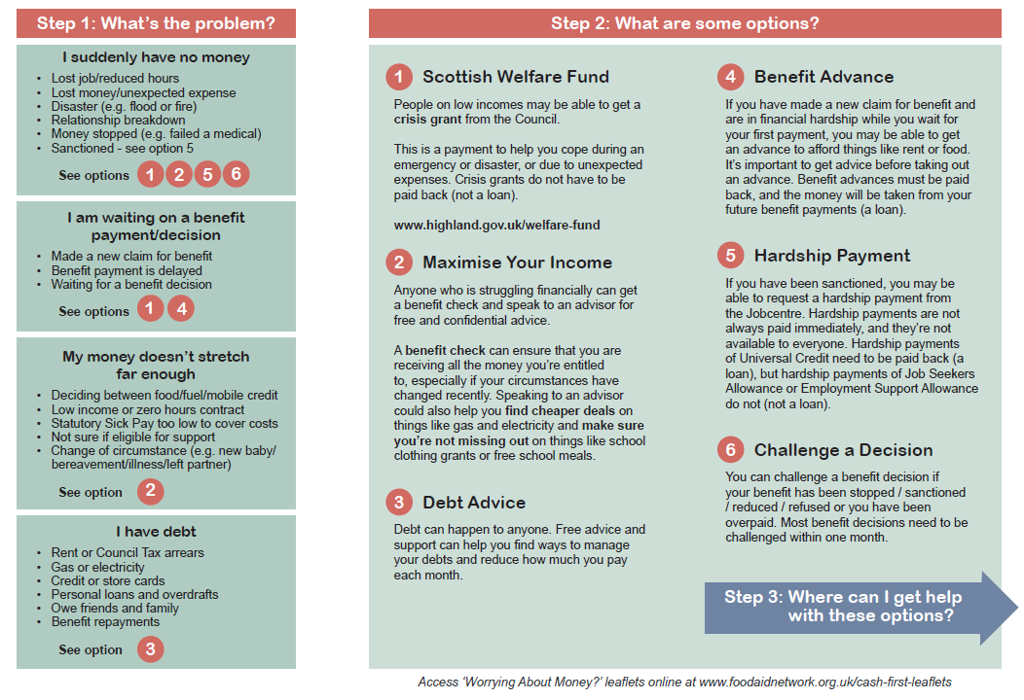
Cash First Referral Leaflet
Notes:
Step 2 - We can see on this slide what the options for 1, 2, 5, 6 are – Scottish Welfare Fund, Maximise Your Income, Hardship Payment and Challenging a Decision.
Again under each of the steps here there is a further symbol for Where can I get help and if we choose 1. Scottish Welfare Fund we can see there is – A, B, C

Slide 12
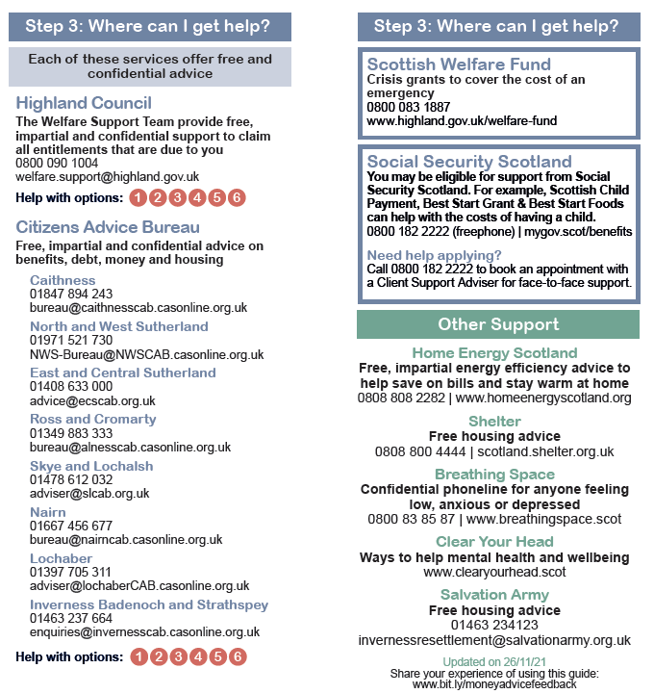
Cash First Referral Leaflet
Notes:
Step 3 – the options were A, B, C – so we can see here that this give us the Welfare Team at Highland Council, CAB and Scottish Welfare Fund.
Each has a phone number as well as a website so if you were in a position to help them make the call or access the website this might mean they are more likely to seek help there and then.
This might be especially true for someone who is in crisis – they might be scared, lacking confidence, not wanting to seek help alone, feeling overwhelmed and not able to make decisions etc.
There are some additional sources of support listed on the back of the leaflet which might also be useful

Slide 13
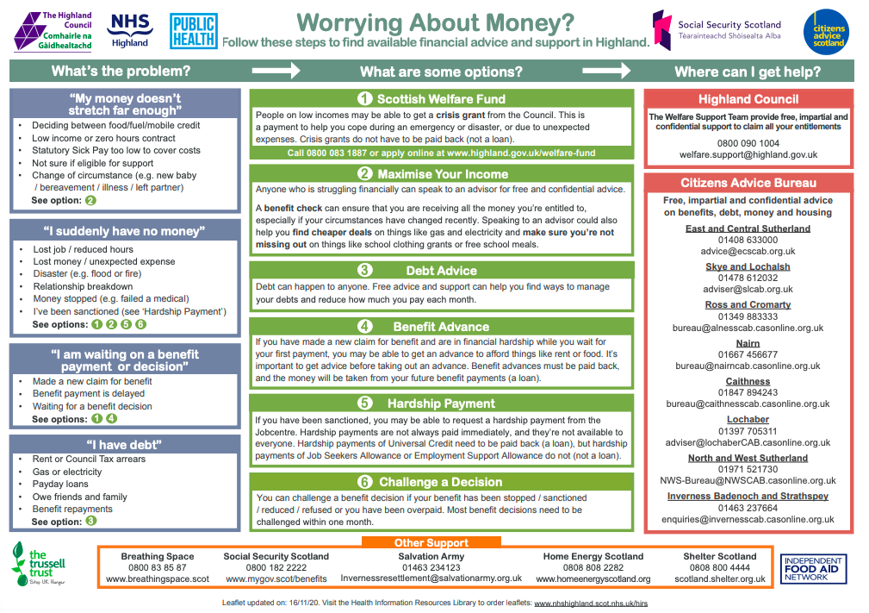
Notes:
This is essentially the leaflet in a ‘single-sided’ format so that you can use to easily access the same info as in the leaflet.
Copies of this can be emailed to course participants

Slide 14
How to access the
‘Highland: Worrying About Money?’ leaflets?
https://www.foodaidnetwork.org.uk/cash-first-leaflets
or contact Maria Marshall or Sabine Goodwin at admin@foodaidnetwork.org.uk

Slide 15
How might you use the leaflet?
Notes:
Ask for feedback on how the participants might use the leaflet – encourage people to give verbal feedback but if they want to use chat that is fine too.
Summarise – refer back to how to ask the question and how you might work through the leaflet with an individual – give an example if this has not come through in the discussion.

Slide 16
Framing the Question...
Listening
Using open questions
Asking permission
Exploring the information
Offering up information
Not making assumptions
How can I help?

Slide 17
There are lots of people struggling with money at the moment. Would you know where to get support if you needed it?
Can I give you information about a leaflet that other people have found helpful?
What are your thoughts on contacting another organisation that can offer help?
Asking the question...
Can I ask if you have seen this leaflet?
What do you know about the welfare team/CAB/Home Energy Scotland? Can I give you more information on any of these?
When someone accesses our service, there may be more help we can provide. Can I help you with anything else?
Notes:
Some examples of what you could say to open the conversation with someone. The key is to ‘offer’ the information in a inclusive and gentle way. People tend to respond better to being offered something than being told it.

Slide 18
Confidence to talk about money?
On a scale of 1 – 10, where 1 is no confidence
and 10 is very confident - How would you rate
your confidence to talk to someone about money?
Notes:
In order to access if the course has met its learning outcomes, please use the chat to indicate what your confidence levels are now

Slide 19
Knowledge of support
On a scale of 1 – 10, where 1 is no knowledge and 10 is high level of knowledge- How much do you think you know about services which help people maximise their income?
Notes:
Again, can you pop your response in the chat as either a number or low, medium or high

Slide 20
Any Questions?
Find out more about cash first referral leaflets: www.foodaidnetwork.org.uk/cash-first-leaflets

Slide 21
This training is based on resources developed by the
Highland Money Counts Partnership.
Partners include The Trussell Trust, NHS Highland, Highland Council and Social Security Scotland, in partnership with the Independent Food Aid Network and Nourish Scotland.

Slide 22
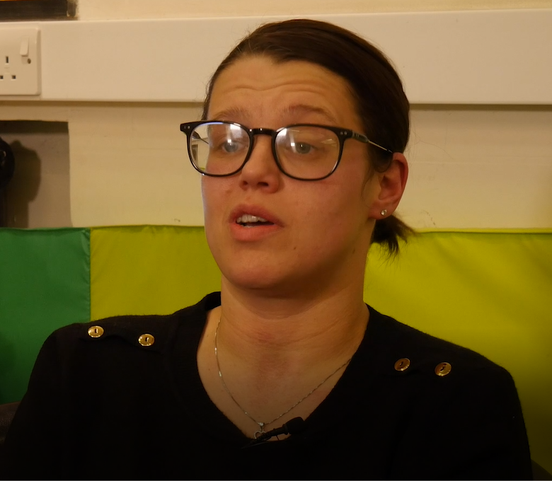
Accessing services – real stories
Donna’s Story
Lisa-Marie’s Story
Notes:
2 short videos about individuals experience of accessing foodbanks.

